Slide 1

Guidewire Test Automation POC using Codeception/Selenium Webdriver Framework By: Yadwinder Sharma CEO – www.getskills.co.nz CBD Offices, Level 4, 17 Albert Street Auckland Central Auckland Contact: admin@getskills.co.nz

Slide 2
Advantages
Open source ; So no licensing costs
Power of Crowd ; Never short of skilled developers to build , maintain and troubleshoot your automation framework
A behavior driven development framework that encourages the clarity of the requirements and test cases to be automated
Fast delivery and Feedback ; Witness a fully functional automation framework for your product within 2 weeks.

Slide 3
Capability
Virtual capability of 50 skilled NZ based testers
25 open source automation developers based in India, Italy and Australia.
A New Zealand based system Team to test the automation framework before the client delivery
Automation framework deployment on Amazon ec2 cloud infrastructure set up as per your requirements

Slide 4
Codeception (MIT Licensed Open source)(www.codeception.com)
Modules and Features
Selenium WebDriver integration – Out of box Selenium functions (http://codeception.com/docs/modules/WebDriver)
Browser Stack and Saucelabs integration to run tests on various platform configurations
Elements matched by name, CSS, XPath
PageObjects and StepObjects included
BDD-style readable tests
API testing: REST,SOAP,XML-RPC
Data Cleanup/Database Modules
HTML, XML, TAP, JSON reports
CodeCoverage and Remote CodeCoverage
Parallel Execution

Slide 5
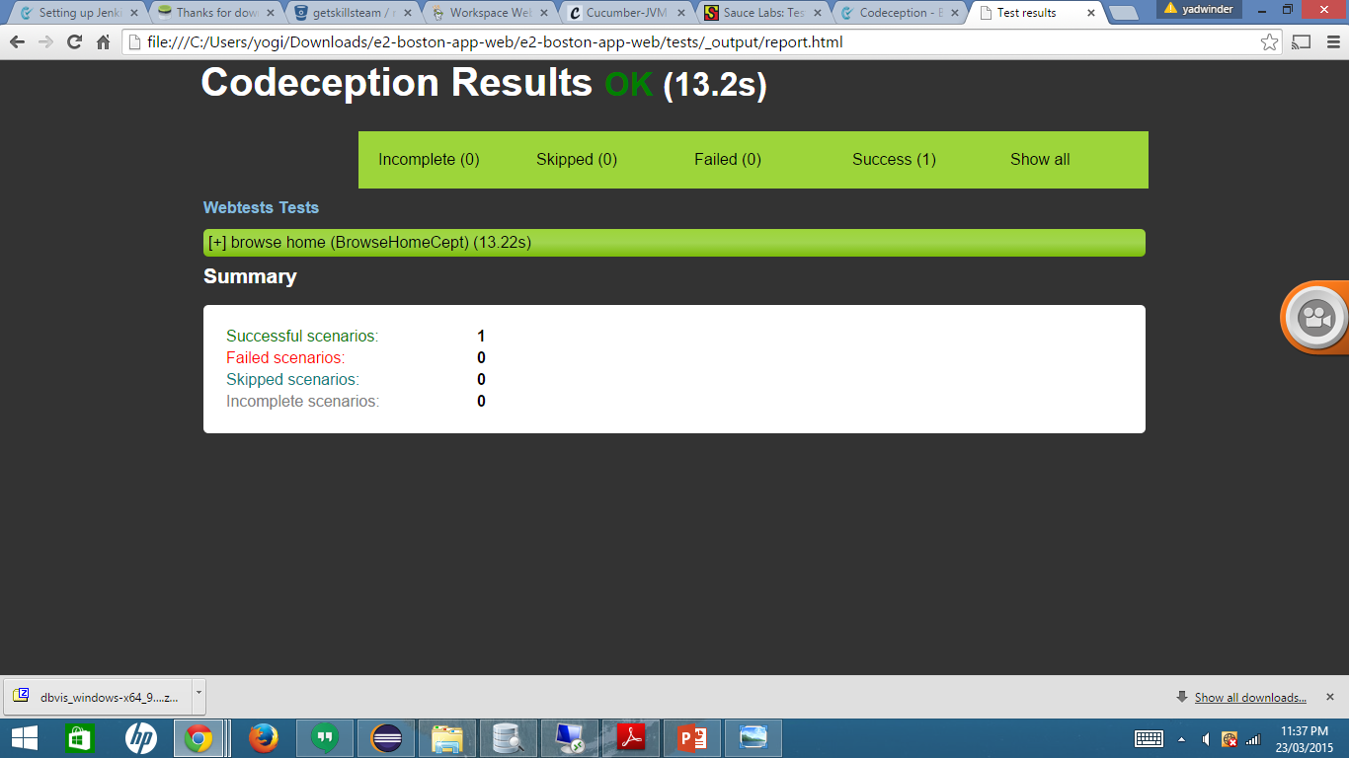
Codeception Reports

Slide 6
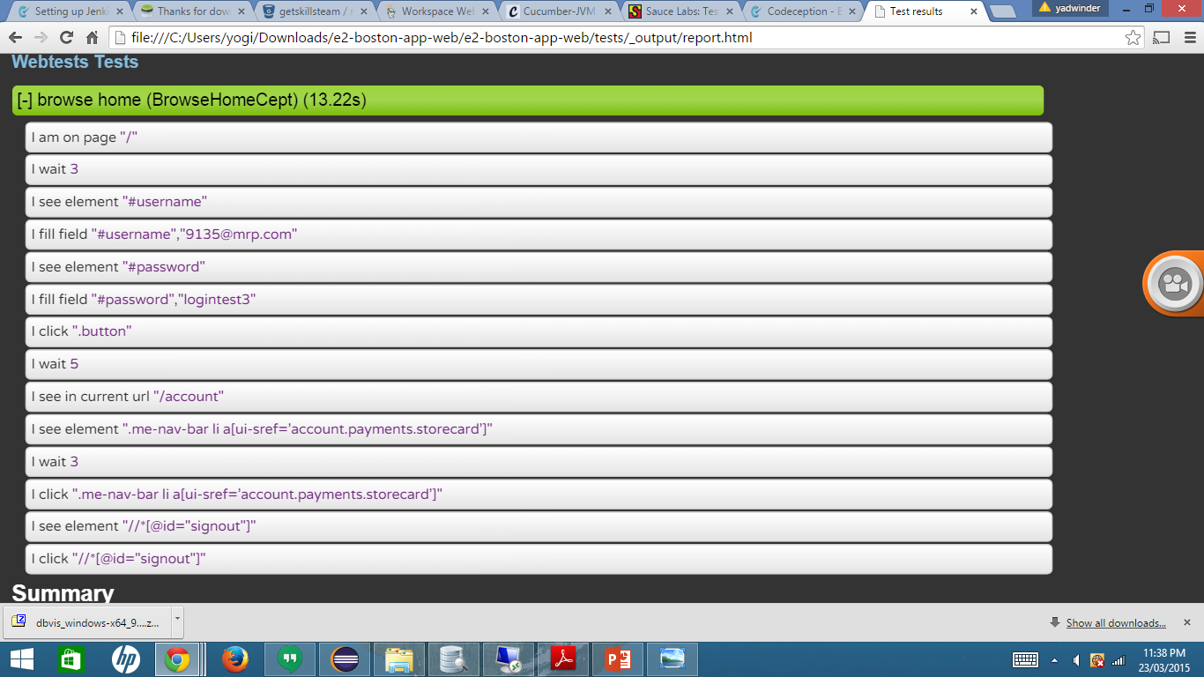
Test Example

Slide 7
Chelmer Case Study
Financial Product Company
10 NZ based clients
Each client has its own web based Chelmer system to manage equity trading operations

Slide 8
Major Issues:
Each change in the system creates a huge amount of testing work to test systems of all clients
Not enough testing and BA resources to manage testing across different platforms
Continuous Integration server (Bamboo) is in place , but no process to get faster and instant feedback to devs on their code

Slide 9
Challenge: Running same framework for multiple Chelmer clients
Chelmer Automation Framework
Craig
URL- www.craig-Chelmer.co.nz
Username: craig
Password: test1
Client id: 100100
Murray
URL- www.murray-Chelmer.co.nz
Username: murray
Password: test2
Client id: 100200
JB
URL- www.jb-Chelmer.co.nz
Username: murray
Password: test3
Client id: 100300

Slide 10
How we solved it !
Created a framework that supports
Single Configuration to run same tests for different Chelmer clients
Instant Reporting on bamboo server
Integration with Browserstack to run tests on multiple platform configurations
Parallel execution of the tests to get feedback to devs in minutes instead of hours
Instant Reporting that can be accessed even via mobile phone
Repository to keep both success and failure screenshots of the test cases

Slide 11
Pumpkin Patch Case Study
Retail company
Online portals for UK, US, NZ, Australia and Ireland markets
All portals are developed and maintained by NZ based development team

Slide 12
Major Issues:
Going to launch a mobile responsive portal for all countries in a sequence launch
Not enough testing resources to test new portals of all countries on all supported platform configurations
Still following traditional development and delivery approach

Slide 13
Challenge: Running same framework for Pumpkin patch websites for all countries
Pumpkin patch Automation Framework
Pumpkin Patch US
URL- www.pumpkinpatch.us
Username: mike
Password: mike123
Pumpkin patch NZ
URL- www.pumpkinpatch.co.nz
Username: craig
Password: craig123
Pumpkin Patch Australia
URL- www.pumpkinpatch.com.au
Username: tom
Password: tom123
Pumpkin Patch UK
URL- www.pumpkinpatch.uk
Username:john
Password: john123
Pumpkin Patch Ireland
URL- www.pumpkinpatch.ie
Username: george
Password: test3

Slide 14
How we solved it !
Created a framework that supports
Single Configuration to run same tests for all 5 pumpkin patch websites
Instant Reporting on jenkins server
Integration with Browserstack to run tests on multiple platform configurations
Parallel execution of the tests to get feedback to devs in minutes instead of hours
Instant Reporting that can be accessed even via mobile phone
Repository to keep both success and failure screenshots of the test cases

Slide 15
Workflow
Codeception.phar
Selenium Server
Running on Browser
(Firefox)

Slide 16
Overview of Framework
Pages
Elements
MemberStep
Function Definition
TestCept.php
Function Calling

Slide 17
Framework structure
Pages – To hold the elements of pages of the whole Chelmer product
AcceptanceHelper – To hold the common functions
Acceptance – To hold Tests files( Cept suffixes)
Output – To hold generated output reports( html, xml format) and screenshots of test cases success and failures
Yml files – To hold Framework configuration e.g environments, urls, browser, variable info

Slide 18
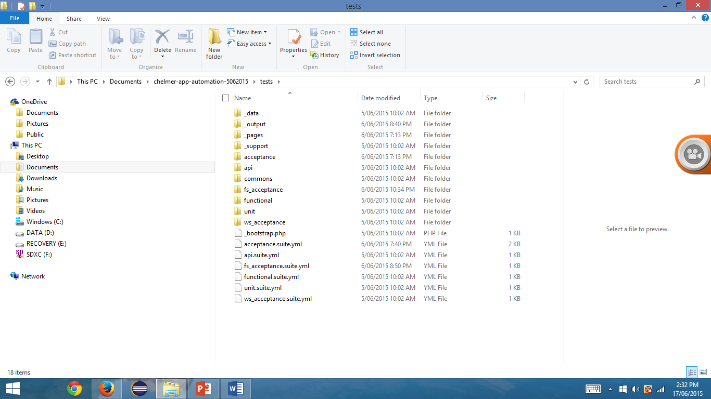
Framework structure

Slide 19
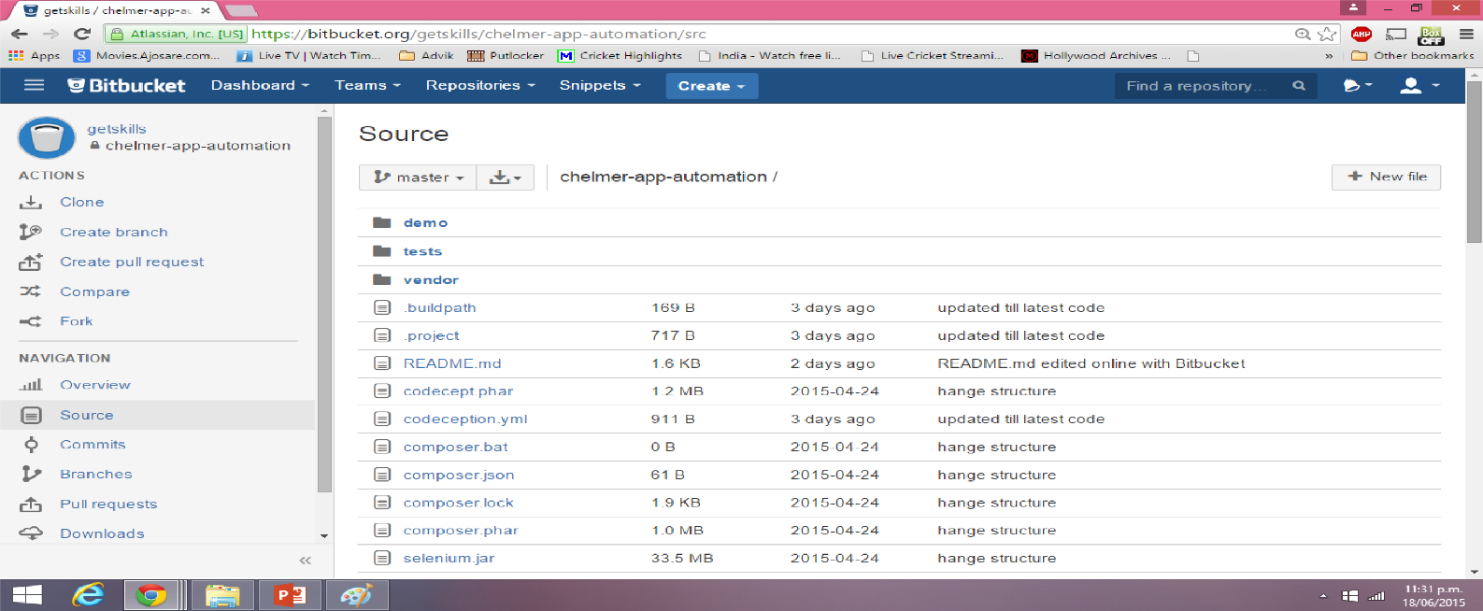
Tools: Bitbucket (source code management )

Slide 20
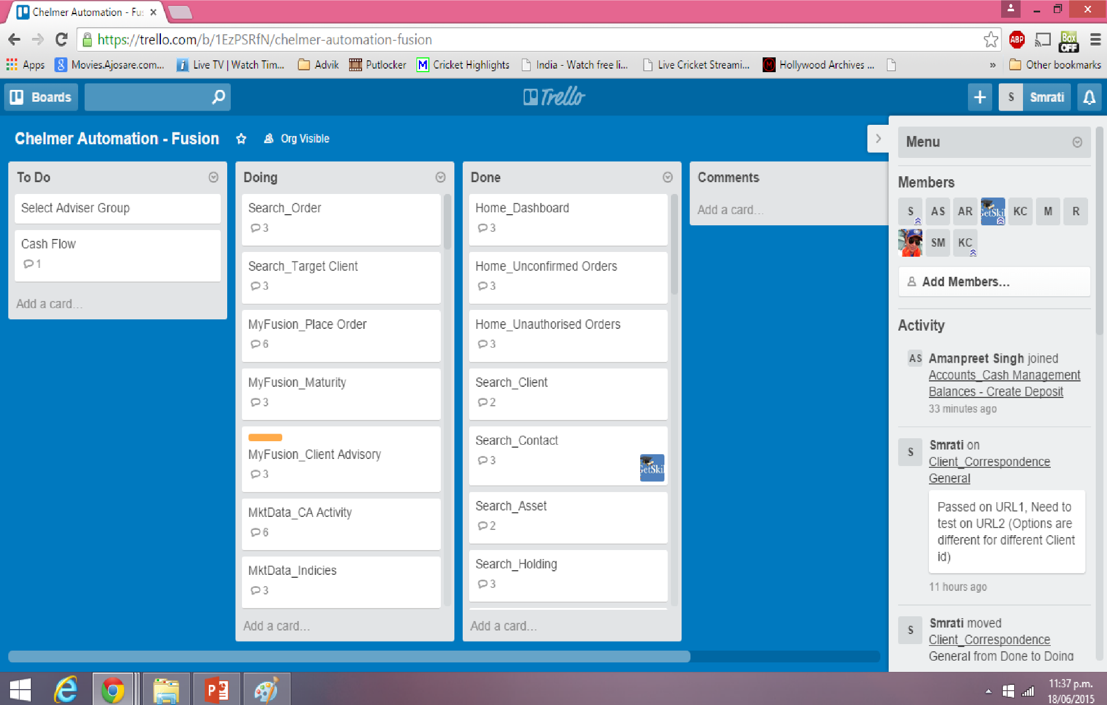
Tracking with Trello

Slide 21
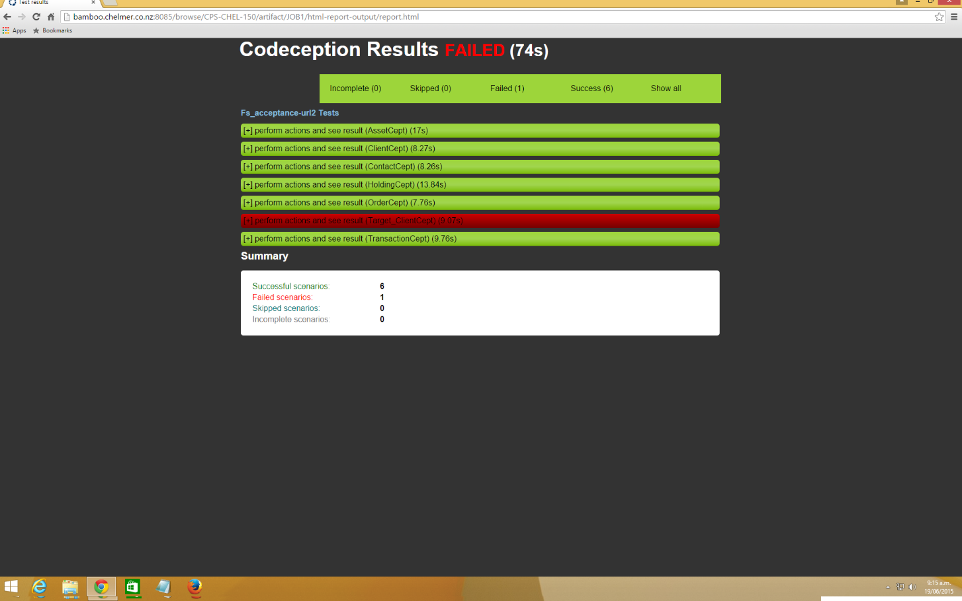
Report on bamboo server

Slide 22
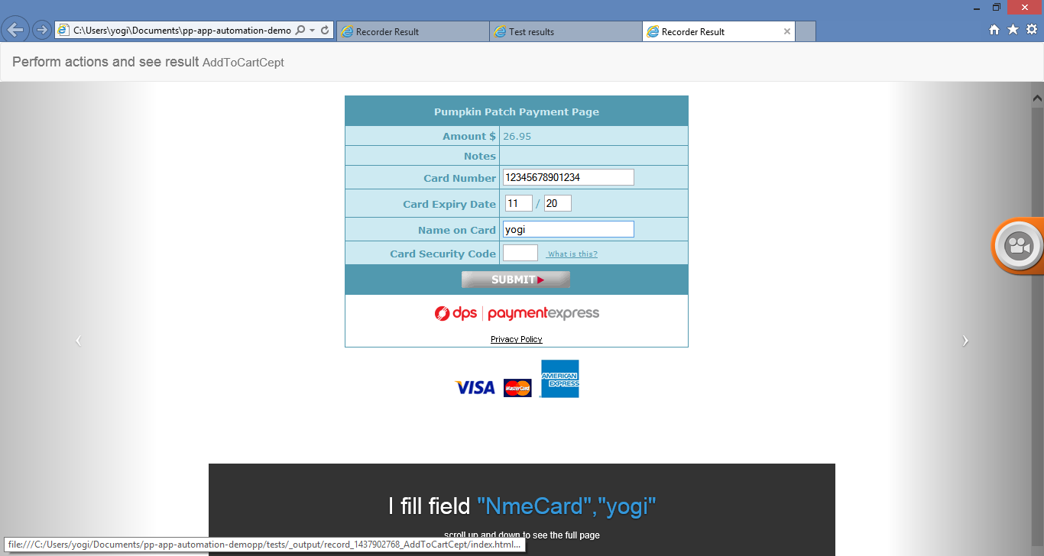
Slide Show of each test case with Test step information

Slide 23
Continuous Integration Process
Compile
Developer commits the code in the develop branch , executes micro/unit tests and generate a unit test coverage report in Sonar
CI
Deployment in dev environment gets triggered automatically with a commit following with automated smoke, integration tests and codeception acceptance tests
QA
Stable compiled code is deployed in QA for demo and UAT purposes following with automated smoke, integration tests and codeception acceptance tests

Slide 24
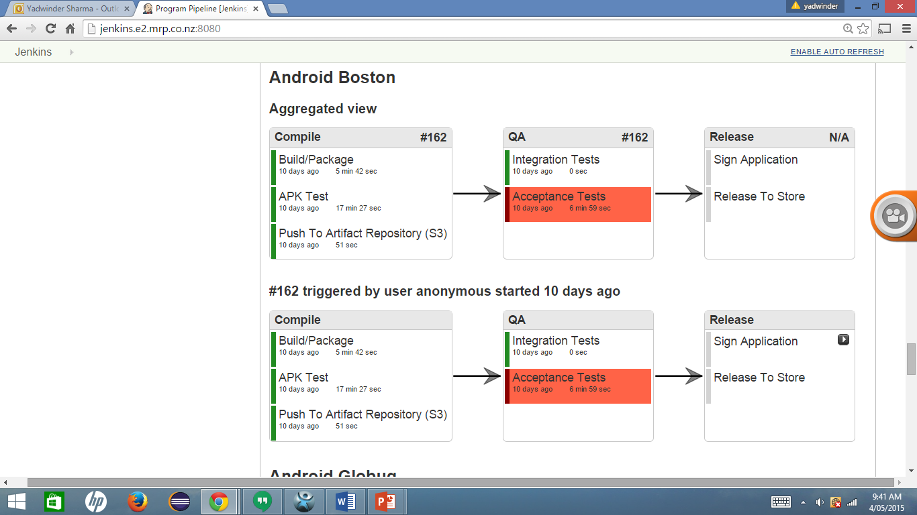
Visualisation of Continuous Integration pipeline

Slide 25
Guidewire Pilot/Poc Process
Tasks:
Set up Continuous Integration Server
Set up the framework structure and configure pilot test cases
Deploy the Framework on Continuous Integration server
Reporting set up
Require: Guidewire Demo system from Tenzing
Location: Can be done at Tenzing or Getskills offices
Cost: Getskills will take care of this
IP of Guidewire Test Automation Framework : Will belong to Getskills. Tenzing can rent this framework to its clients including Guidewire

Slide 26
About Getskills
Founded in 2013
Delivered a software testing upskilling program for WINZ
https://www.youtube.com/watch?v=vhwdSaqoZdU
International software testing qualification and Australia NZ Testing board accredited training provider
Provide Open source Test Automation and CI Trainings
Provided Open source test automation and CI solutions to NZ financial and retail companies
Currently working on a few Pilots and POCs

